Slide 1

Organisers Instructions
Notes:
History
V1.0 – First upload

Slide 2
Contents
Overview
Kit contents, You will need....
Charging the m3pi, Programming the m3pi
Setting up the track and barrier
Setting up and testing the beam breaker and timer
Running the leader board
The Rules
Registration at mbed.org
Resources for entrants
Wii Racing – Setup, pairing and driving
Bluetooth RPC and Bluetooth racing

Slide 3
Overview
The mbed Robot Racing event is about driving the m3pi robot around a track in the fastest possible time
The driving can be
  interactive, using the Wii Wheels
  Open loop controlled, with a predetermined path
  Close loop controlled, with a line following algoritm

Slide 4
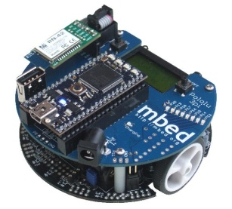
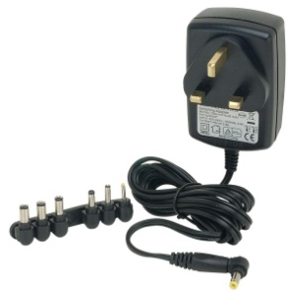

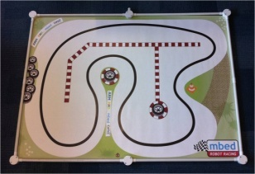
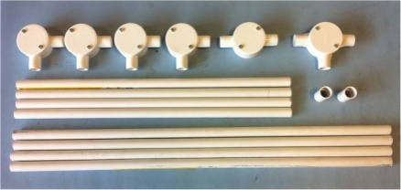
Kit Contents
The mbed Robot Racing Kit, including:
  6 x m3pi robots
  6 x Bouetooth USB dongles
  3 x 9v DC Wall adaptor
  1 x Beam Breaker assembly
  1 x 12 DC wall adaptor (for the beam breaker)
  2 x Wii Wheels
  1 x Printed track
  7 x USB Cables
  1 x 20mm white conduit barrier assembly
  12 x Ping pong balls

Slide 5
You will need...
Make sure that you have the following
  6 full charged m3pi robots (charge them before the event!)
  A flat table big enough for the 2A0 track (119cm x 168 cm)
  4 x AA batteries for the Wii Wheels
  Computers with internet access for the users
  A laptop to run the racing timer
  A whiteboard, PostIt notes and a marker pen for the leader board
  mbed Signup codes for the user to create mbed accounts
  mbed Business cards to have to hand

Slide 6
Charging the m3pi
The batteries in the m3pi Robot are not charged
  Use the supplied 9v Adaptor
  A full charge takes around 90 minutes
  It is normal for the circuit board around the “mbed” logo to get warm while charging
  The “charging” LED goes off when fully charged
If the Red charging LED doest not come on, look between the two m3pi circuit boards to check the batteries have not come out of the holders during transport. If they have, they can usually be popped back in place using a pencil.

Slide 7
Programming the m3pi
The m3pi is controlled by the mbed Microcontroller mounted on top of it
The behaviour of the m3pi is defined by the program that is saved onto the mbed Microcontroller
To program the mbed :
  Plug it into a PC with the supplied USB cable, and a flash drive will appear – that is the mbed.
  Save the desired program (.bin) file to the flash drive
    Examples can be found in the resource pack linked at
      http://mbed.org/cookbook/m3pi-RobotRacing
  Unplug the USB cable from the mbed
  Switch the m3pi on using the on/off button by the LCD

Slide 8
Setting up the track
The printed track measuring 119cm x 168cm
It needs to be laid out on a smooth surface. If there are joins (two tables pushed together) make sure the join is as smooth as possible
Be sure to assemble the barrier unless the track is on the floor!

Slide 9

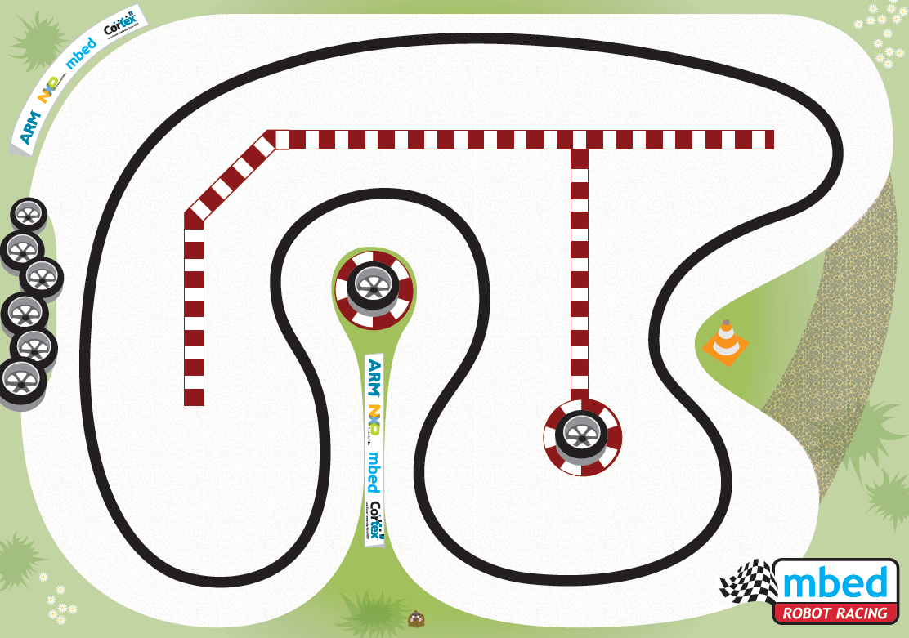
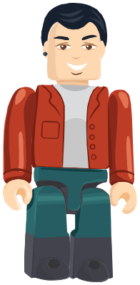
Setting up the track (2)
Beam breaker
Contestant(s)

Slide 10

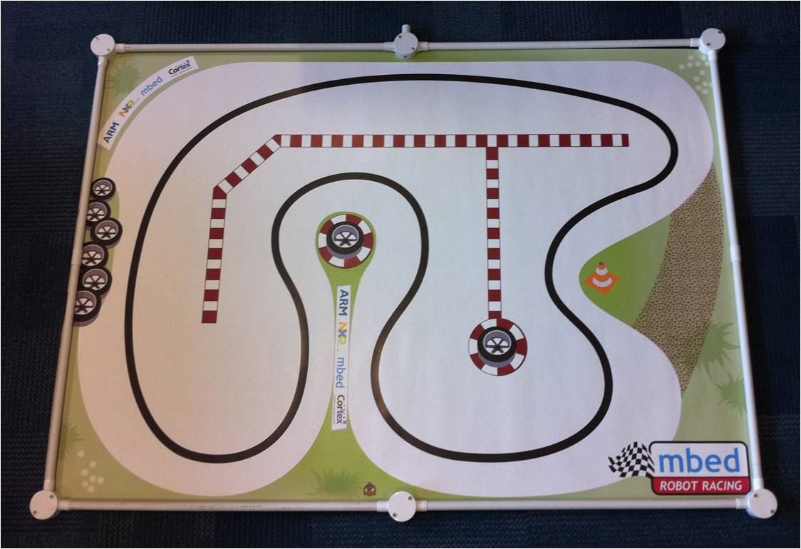
Setting up the barrier
C
D
E
The Barrier assembly consists of
  4 x 75cm tubes (A)
  4 x 55cm tubes (B)
  4 x corner connectors (C)
  1 x through connector (D)
  1 x “T” connector (E)
  2 x tube couplers (F)
B
F
A
C
C
A
A
E
B
B
F
F
B
B
C
A
A
C
D

Slide 11
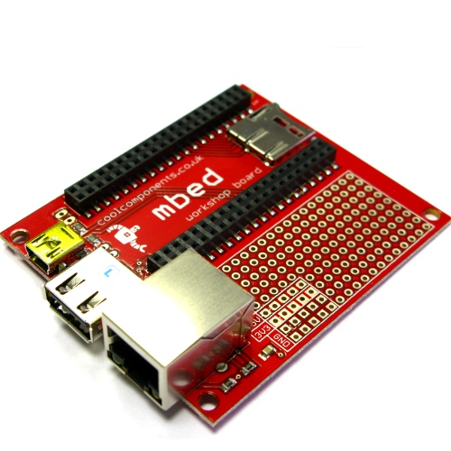
Setting up the beam breaker
The beam breaker is a circuit board containing an mbed, and a laser sensor on a lead
The beam breaker assembly needs:
  Power from the provided 12v DC adaptor
  Connection to the computer via a USB
  Note, connect using the USB connector
  on the red circuit board *not* the mbed
Stick the laser to the track using blue tack, pointing across the start/finish line, about half way
The mbed is programmed with USBLineDetector program which can be found in the resource pack link from
    http://mbed.org/cookbook/m3pi-RobotRacing

Slide 12
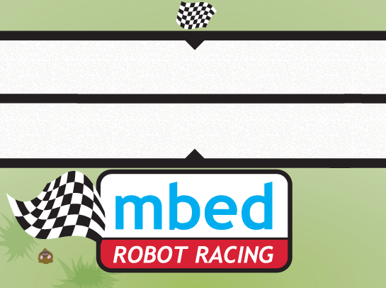
Setting up the beam breaker (2)
Place the reflector on the inside side of the track, securing it with a little blue tack
To beam breaker board
Beam breaker laser at edge of track, with sensors facing to the middle of the track
Reflector mounted vertically to reflect the beam

Slide 13
Testing the Timer
The timer is implemented as a stand along HTML file that can be loaded into any browser.
Timer page will reset and start the time when the pipe “|” character is pressed on the keyboard, or sent by the beam breaker.
The second pipe character stops the timer.
The HTML file is in the mbedRobotRacingResource archive
  http://mbed.org/media/uploads/chris/mbedrobotracingResource.zip

Slide 14
Leader board
The leader board is “Top Gear” style
  Each new timed attempt will have to go on the leader board
  Use the post it notes and marker pens to create names with their lap time, and juggle them around as the competition heats up!

Slide 15
The Rules
A Rolling Start is required. The first break of the beam starts the timer, the second break stops it
No short cuts or excursions “across the grass”
The judges word is final

Slide 16
Registration at mbed.org
Resources for the m3pi robot, including the online compiler, are available on the mbed website at
http://mbed.org/cookbook/m3pi
To register on the mbed website;
  You will need an mbed plugged into your computer, and a signup code.
  The process is explained at : http://mbed.org/handbook/Signup-Codes
Sign up codes can only be used once. Contact support@mbed.org for additional codes for each event

Slide 17

Resources for Participants
The best resource for the participants can be found
  http://mbed.org/handbook/Homepage
    Complete the “getting started” exercises
  http://mbed.org/cookbook/m3pi
    This is the home page for the m3pi robot and contains two useful examples
      Open loop “Hello World” example
      Closed loop line following example
    Both these examples can be loaded directly into the compiler using the import button

Slide 18
Wii Racing - Setup
The m3pi has a USB host socket and 6 USB Bluetooth Dongles were supplied with the kit, which enable connection with a Wii Wheel
Prepare the m3pi
  Plug in the USB Bluetooth dongle
  Plug in the mbed, and program it with the Wii Racing program found in the Resource pack linked at :
    http://mbed.org/cookbook/m3pi-RobotRacing
    Reset the mbed to load the program,
    wait until the LCD says “Wii Racing” then turn the m3pi off

Slide 19
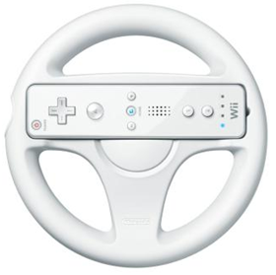
Wii Racing - Pairing
Once the m3pi has been set up, pair it with the Wii Wheel :
  Hold down and hold buttons 1 & 2 on the Wii Wheel,
  the four LEDs will now flash
  After a few seconds, the flashing will (very) briefly pause
  Now turn on the m3pi, the Wii Wheel is now attempting to pair
  When the LED stops flashing, either :
    One LED will remain on, indicating they have paired
    No LEDs will be on, turn off m3pi, and try the process again

Slide 20
Wii Racing - Driving
Once the Wii Wheel is paired, you can now control the m3pi
  Button 2 – Forward
  Button 1 – Reverse
  The arrow keys...
  ....you’ll have to experiment!

Slide 21
Bluetooth RPC Setup
If an m3pi is fitted with an RN-42 blue tooth module, it can be paired with Bluetooth enabled computer and controlled interactively with RPC commands
    This is the RN42 module.
    Not all m3pi robots have this.

Slide 22
Bluetooth RPC Setup
When the m3pi is switched on it can pair with a laptop, where a new COM port is created for serial commands to be sent to the robot
The m3pi needs to be running the BluetoothRPC program
  See http://mbed.org/cookbook/m3pi-RPC for more detail
When you have a Bluetooth connection established, you can control interactively from a terminal program, or from your favourite scripting language!
  The BluetoothRacing python application can be found at http://mbed.org/cookbook/m3pi-RPC

Slide 23
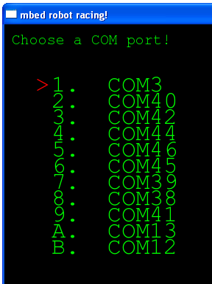
BluetoothRacing
When you run BluetoothRacing.exe, the following window will appear
Use the arrow keys to select which COM port you are using
Press “enter” to select the port
After a short delay, the control window will appear

Slide 24
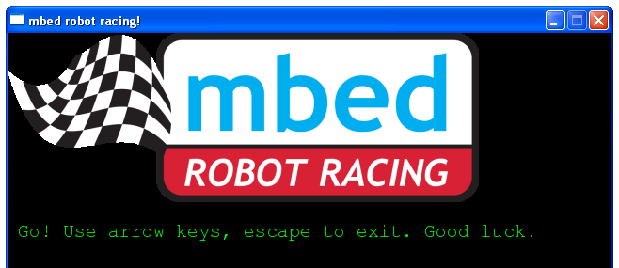
BluetoothRacing
As per the instructions, arrow keys to control, Escape to exit
If the robot is accidentally switched off, close the application, turn the robot on, and restart.
Have Fun!

